Slide 1
Purwadhika JCDSAH Final Project
Matplotlib Team

Slide 2






Matplotlib Team
Elvan Selvano
Gusti NA Kresna
Rafif Hendrawan
Mastering Computer Science
Binus University
Bachelor of
Industrial Engineering
Sepuluh Nopember Institute of Technology
Bachelor of Physics Education
State University of Jakarta

Slide 3
Table of Contents
1.
4.
2.
5.
3.
Business Background
Deployment
Data Understanding and Data Exploration
Business Case
Study
6.
Modeling and Evaluation
Conclusion and Recomendation

Slide 4
1
Business Background

Slide 5
Background
We are Data Scientist Team working at a Property Consultant in Washington DC, USA.
Looking to our customer point of view, we want to help them in valuing their properties in no time. Thus, we are assigned to build a price predictor for the properties in DC.

Slide 6

Business Objectives
The objective of this project is to predict the price of a property to help both buyers and sellers to find or determine the best property price without underpricing or overpricing in order to maximize their profit

Slide 7
Expected Output
The output of this project is a web that provide prediction of property price given its features such as: number of bathroom, land area, etc.

Slide 8
Project Limitation
Since we have limitation to our resources, especially time and data, we decide to focus on the residential and excluding property with exceptional grade.

Slide 9
Analytic Approach
Machine Learning Technique
Performance Measures
Supervised learning (regression)
to predict property price
Mean Absolute Error (MAE),
RMSE, MSE, R²
to minimize error of price prediction

Slide 10
2
Data Understanding and Data Exploration

Slide 11

Data Collection
The dataset of DC Residential Properties is downloaded in Kaggle
Data Shape
158,957 Rows
48 Columns

Slide 12
Data Description
Numerical Features
Feature | Description
BATHRM | Number of bathrooms
HF_BATHRM | Number of half bathrooms (toilet)
NUM_UNITS | Number of units
ROOMS | Number of rooms
BEDRM | Number of bedrooms
AYB | Year earliest main portion built
YR_RMDL | Year structure was remodeled
EYB | Year improvement built
STORIES | Number of stories
PRICE (target) | Price of most recent sale
SALE_NUM | Number of times it's been sold
GBA | Gross building area (sqft)
Feature | Description
BLDG_NUM | Building number on the property
KITCHENS | Number of kitchens
FIREPLACES | Number of fireplaces
LANDAREA | Land area of property (sqft)
LIVING_GBA | Gross building area in square feet
LATITUDE | Latitude
LONGITUDE | Longitude
SALEDATE | Date of most recent sale
X | Longitude
Y | Latitude
GIS_LAST_MOD_DTTM | Last modified data

Slide 13
Data Description
Categorical Features
Feature | Description
USECODE | Property use code type
CMPLX_NUM | Complex number
ZIPCODE | Zipcode
CENSUS_TRACT | Census tract
HEAT | Heating type
AC | Air Conditioner availability (Y/N)
QUALIFIED | Internally used indicator to reflect if a sale is representative of market value according to the office's internal criteria
STYLE | Type of story
STRUCT | Building structure
GRADE | Property Grade
CNDTN | Property Condition
EXTWALL | Exterior wall type
ROOF | Roof type
Feature | Description
INTWALL | Interior wall type
SOURCE | Raw data source
FULLADDRESS | Full street address
CITY | City
STATE | State
NATIONALGRID | Address location national grid coordinate spatial address
ASSESSMENT_NBHD | Neighborhood ID
ASSESSMENT_SUBNBHD | Subneighborhood ID
CENSUS_BLOCK | Census block
WARD | Ward (district is divided into eight wards, each with approximately 75,000 residents)
SQUARE | Square (Part of Square Suffix Lot (SSL) an address identifier in DC)
QUADRANT | City quadrant (NE, SE, SW, NW)

Slide 14
Splitting Dataset
SALEDATE
Dev set
80%
Test set
20%
1947
2018
Before we do EDA and preprocessing, we split the data based on SALEDATE to simulate real world condition, where we have past data to predict the future.

Slide 15
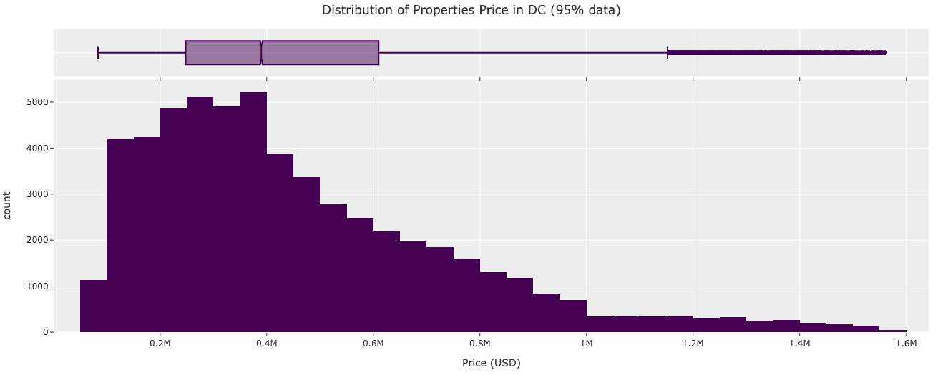
Price Distribution
The chart shows the distribution of the price appears to be right-skewed. The range of the most expensive properties to the median, seems to be far higher than the gap to the lowest. This can reflect to the inequality of DC citizen.

Slide 16
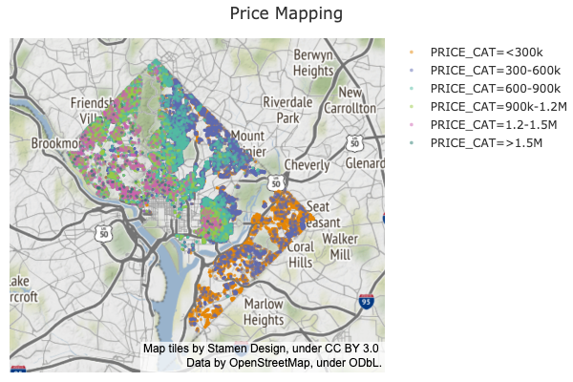
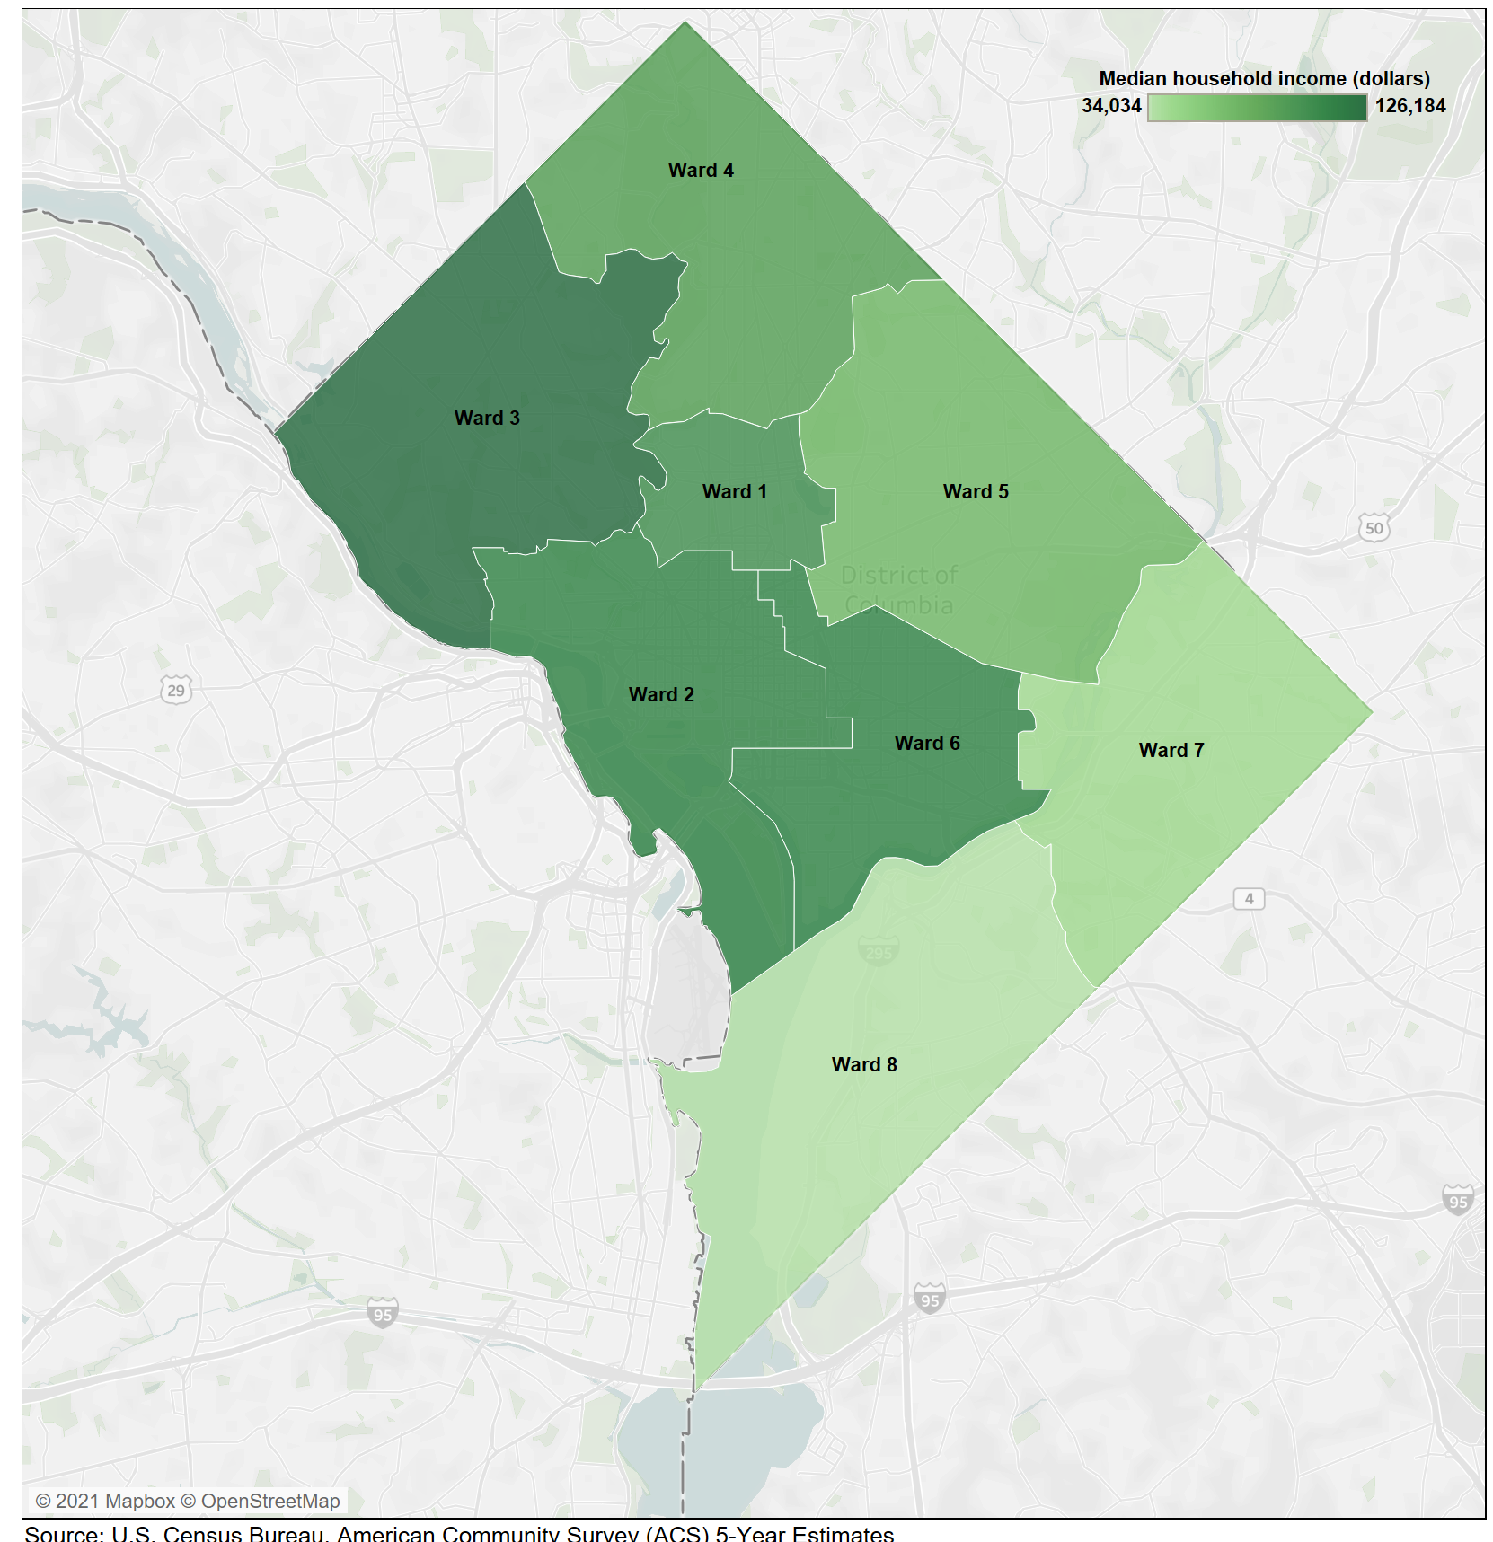
Price Mapping by Location
Price Mapping
Median Household Income (2014-2018)
WARD 4
WARD 3
WARD 1
WARD 5
WARD 2
WARD 6
WARD 7
WARD 8
The left map indicates the price distribution of residential seems different in each location. We can also see the image from DC government entitled Median Household Income on the right. It appears the price distribution of properties reflects to the distribution of household income.

Slide 17
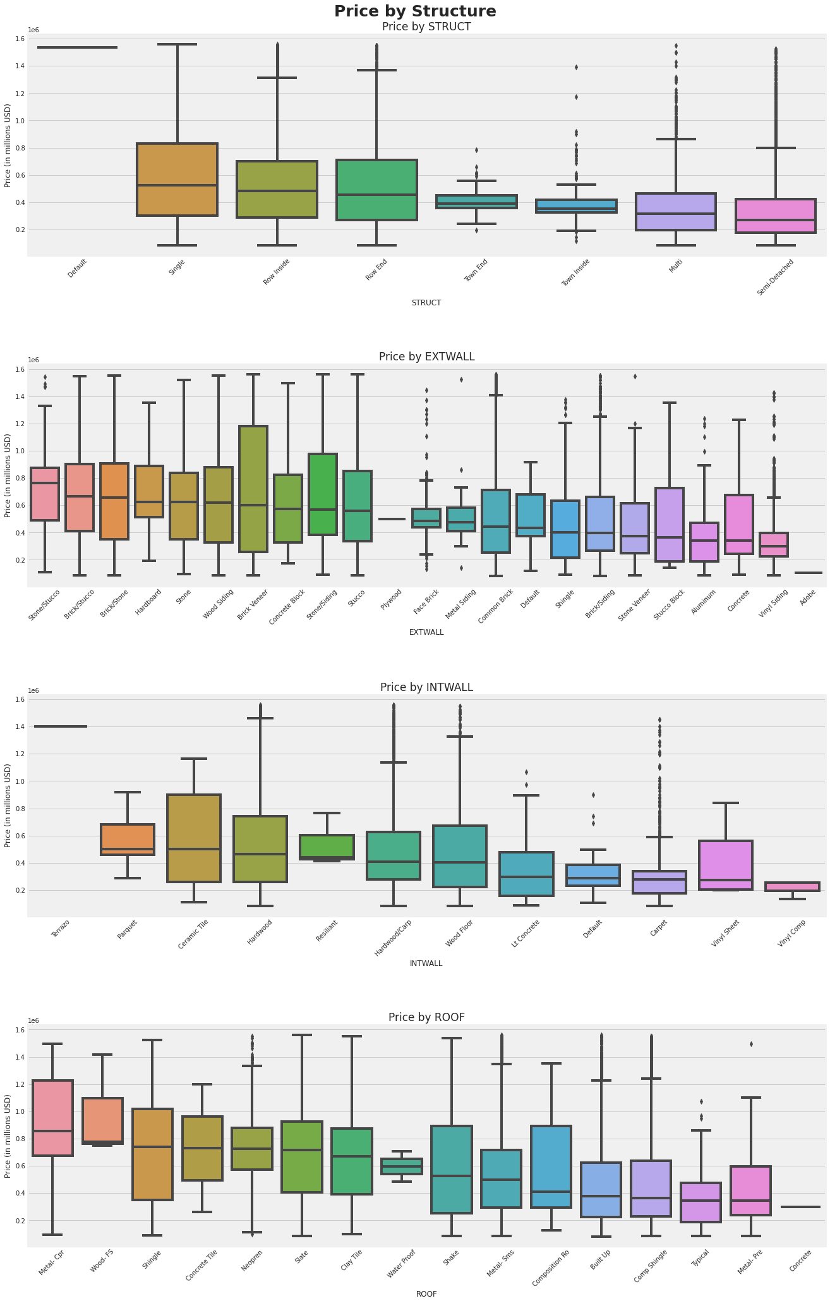
Features on Price (ex: Building Structure & Material)
Based on the median, the boxplots vs price show that each categorical values on each features can distinguish the price. This means the features are good predictor in predicting the price. We ensure this by statistical test.

Slide 18
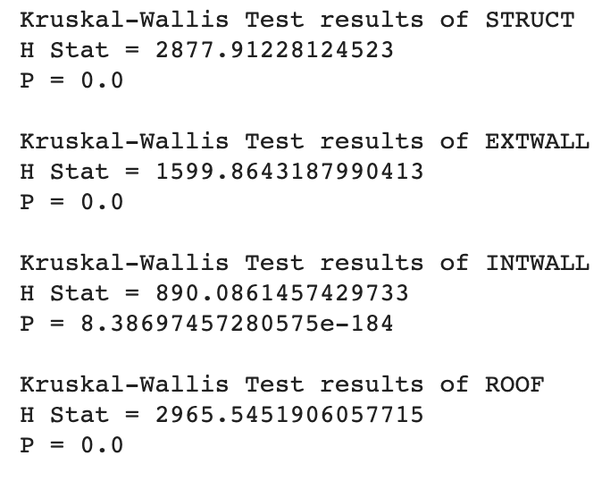
Statistical Test (ex: Building Structure & Material)
Since all the P-Value is less than alpha 0.05, we reject the H₀ which mean the population median (price) for each categorical values in those features is different. This show all features can distinguish price value on 95% confidence interval.

Slide 19
Data Preprocessing
Casting,
Add SALEYEAR
Handling Missing Data
Drop Unusual Values
Encoding
Drop ”Unqualified”
Feature Selection
Feature Engineering
Notes:
Dropping unused features :
CMPLX_NUM, LIVING_GBA, CENSUS_TRACT : only available in condominium data
ASSESSMENT_SUBNBHD, FULLADDRESS, NATIONAL GRID, and CENSUS_BLOCK : high cardinality
CITY, STATE : single value (Washington, DC)
X, Y : same value with LONGITUDE and LATITUDE
SALEDATE : replaced with SALEYEAR

Slide 20
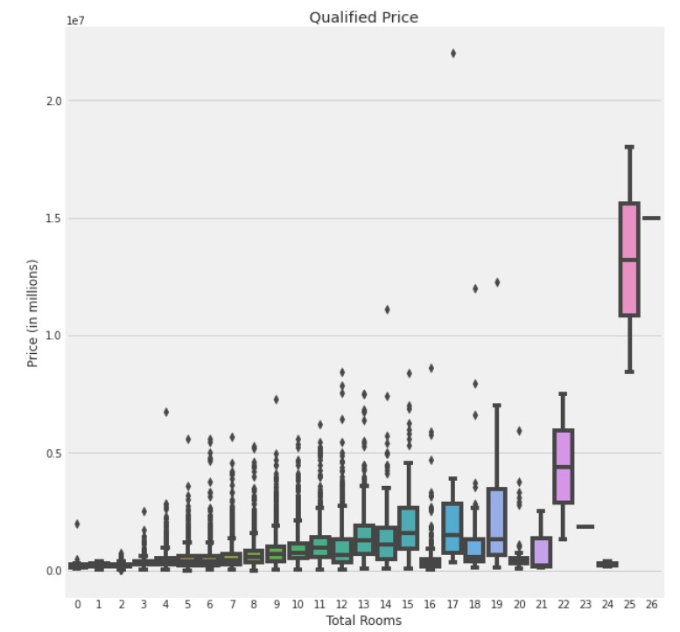
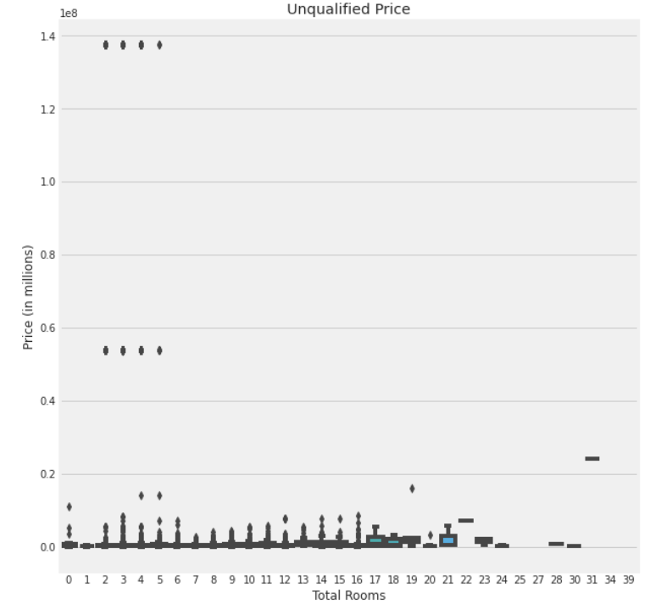
Qualified Features
The author said that the unqualified means the price does not reflect the market value and suggested to drop it. Since the charts also support the statement, we decide to exclude the unqualified.
Notes:
Based on the charts above, we can see that the unqualified property does not reflect the market value. Therefore, we will follow the author's suggestion to remove all of the unqualified property from our dataset. Then, we will remove the QUALIFIED feature because now it only contains a single value which is Q.

Slide 21
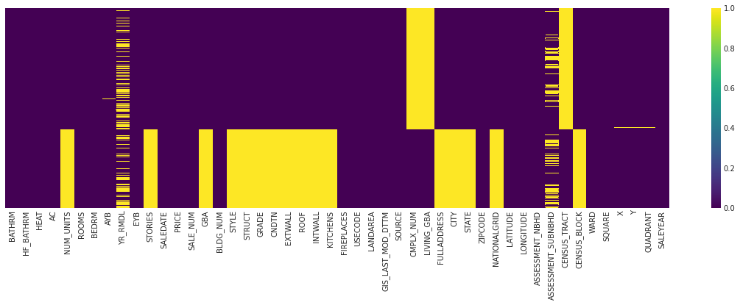
Handling Missing Data
SOURCE
Residential
Condominium
The dataset comes from two sources that have several different features. We assume to predict those two, will require different features. Since we have less missing values on residential, we limit our project only on residential property.

Slide 22
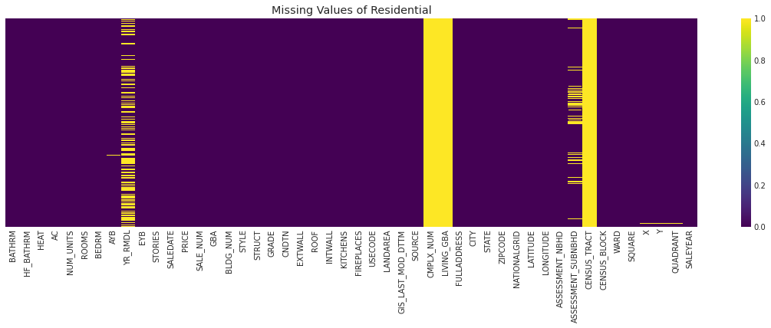
Handling Missing Data (continued)
We also drop some features as follows :
CMPLX_NUM, LIVING_GBA, CENSUS_TRACT : condominium features
ASSESSMENT_SUBNBHD, FULLADDRESS, NATIONAL GRID, CENSUS_BLOCK : high cardinality
CITY, STATE : single value (Washington, DC)
X, Y : same value with LONGITUDE and LATITUDE
SALEDATE : replaced with SALEYEAR

Slide 23
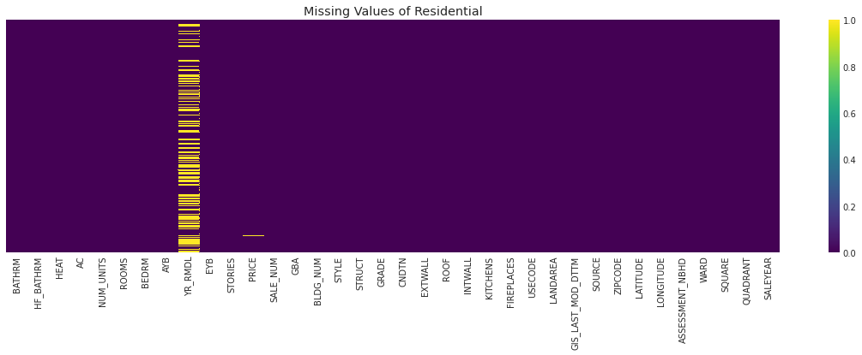
Handling Missing Data (continued)
The YR_RMDL features seems too important to drop. Intuitively, whether the properties have been remodeled or not will affect the price. We decide to do feature engineering by converting the YR_RMDL into RMDL, which is (1/0). 1 means the property has been remodeled and vice versa.
Next, we will drop remaining missing values since the number is insignificant (88 rows)

Slide 24
Feature Selection
- GIS_LAST_MOD_DTTM (update version)
- SOURCE (only residential)
Checking Categorical
Correlation
By Cramér's V
Model Evaluation
Drop Unrelated Columns
Drop Location Features
(Multicollinearity) :
- ZIPCODE
- ASSESSMENT_NBHD
- SQUARE
- QUADRANT
- LATITUDE
- LONGITUDE
Checking Correlation
Numerical
Model performance :
- ROOMS
- USE CODE
Drop Similar Values
- NUM_UNITS (multicollinearity & imbalanced)
- BLDG_NUM (weak correlation & imbalanced)
- STORIES (similar w/ STYLE)

Slide 25
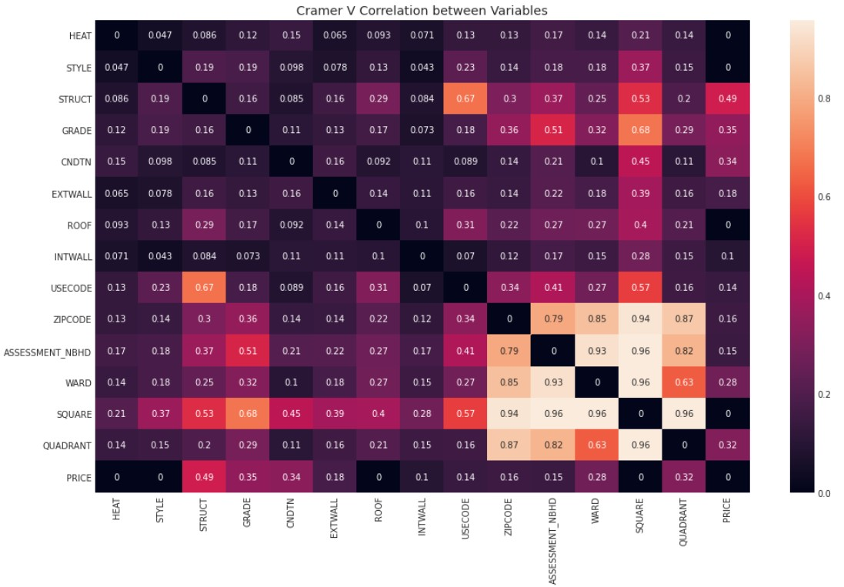
Cramér's V Correlation for Categorical Features Result

Slide 26
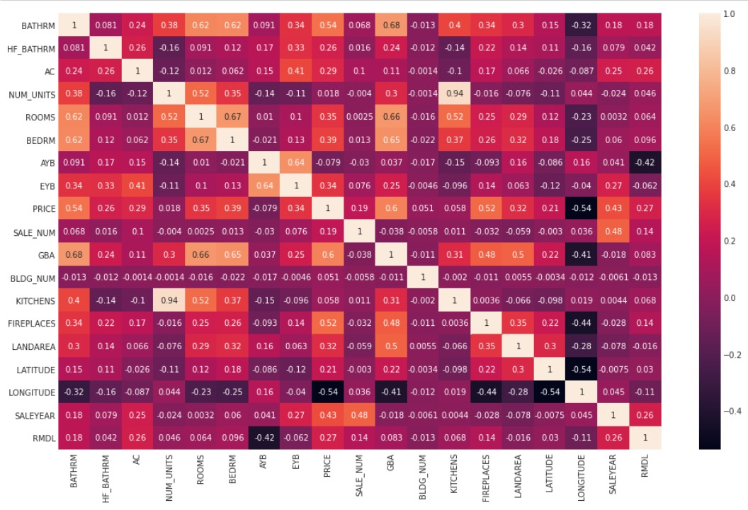
Correlation for Numerical Features Result

Slide 27
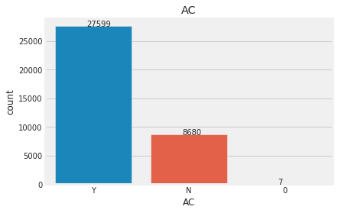
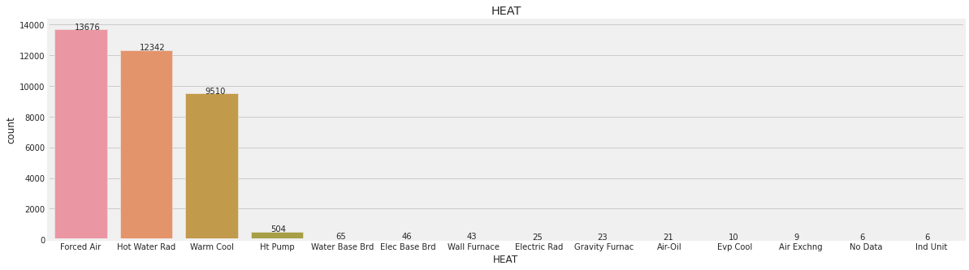
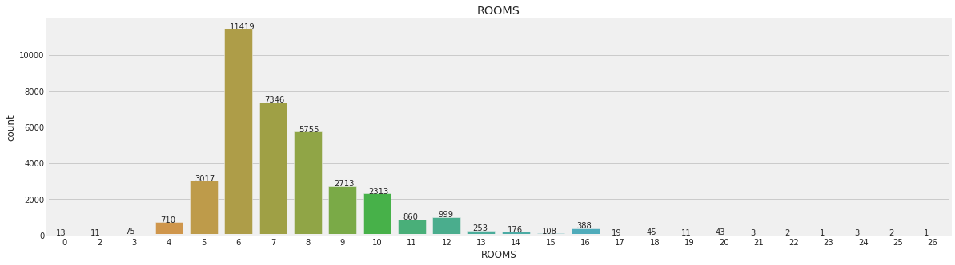
Unusual Values
AC : Change “0” to “N” + Encode
HEAT : Drop rows with ”No Data”
ROOMS : Drop property with ”0” Room

Slide 28
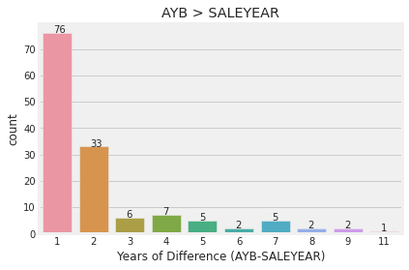
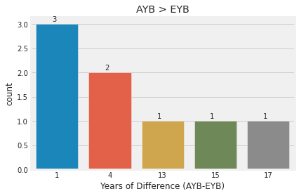
Unusual Values (continued)
Drop AYB > SALEYEAR : We assume that no property has been sold (SALEYEAR) before being built (AYB).
We consider this as mistyping data
Drop AYB > EYB : Based on the author explanation, EYB should be more recent than AYB

Slide 29
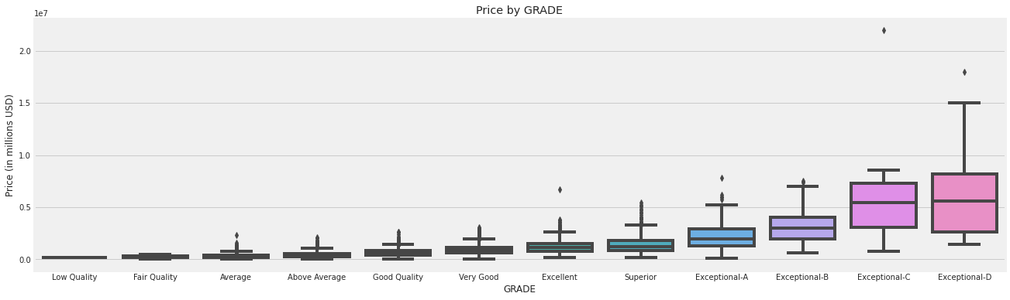
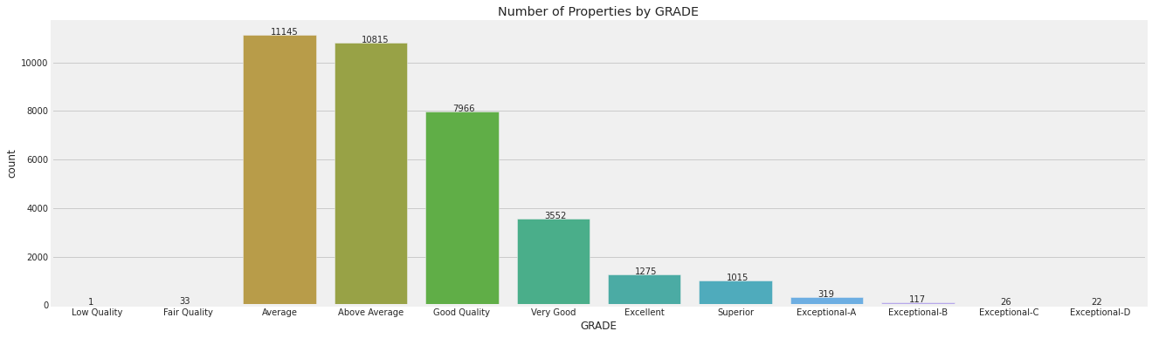
Unusual Values (continued)
Excluding Exceptional Grade :
We can consider the exceptional grade as luxurious property.
Since the price gap are quite high and the records are rare, we decide to limit our prediction model by excluding those in exceptional grade

Slide 30
Feature Engineering & Encoding
A. Create New Features
1. Building age when most recent sale happens
AYB_SALEYEAR_DIFF = SALEYEAR – AYB
2. Last improvement age when most recent sale happens
EYB_SALEYEAR_DIFF = SALEYEAR – EYB
3. Square feet per each room
SQFT_ROOMS = GBA / ROOMS
B. Ordinal Encoding
CNDTN :
Poor → 1 Good → 4
Fair → 2 Very Good → 5
Average → 3 Excellent → 6

Slide 31
3
Modeling and Evaluation

Slide 32

Modeling Steps
Setting up Environment
Comparing All Models
Finalize the model
Creating Baseline Model
Choose the best model and Tune it

Slide 33
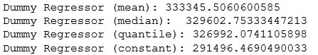
Baseline Model
It is important to create a baseline model so we can see whether our model improved from the baseline and how much did it improve.

Slide 34
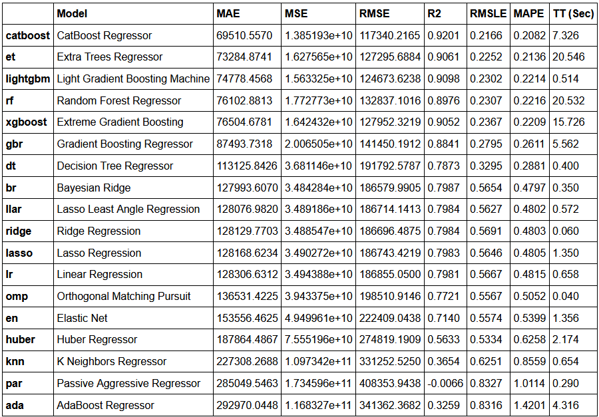
Training Model Result (Dev Set)
We create all the models using 5-fold cross validation.
We will focus on the Mean Absolute Error (MAE) because it is robust to outliers which exist in our dataset.

Slide 35

Choosing The Model
Based on the above benchmark, we can see that CatBoost is the top performing model with Mean Absolute Error of 69510.5570 during the 5-fold cross validation.
Therefore, we will create a Catboost model and tune its parameters in the next step.

Slide 36

Tuning The Model
In model tuning, we use Hyperopt library, an open source hyperparameter optimization framework to automate hyperparameter search.
It efficiently search large spaces and prune unpromising trials for faster results.

Slide 37
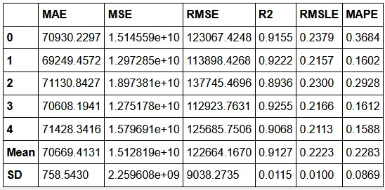
Tuning Result

Slide 38
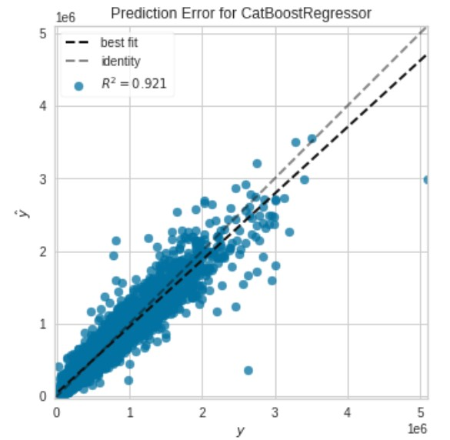
Prediction Error Plot

Slide 39
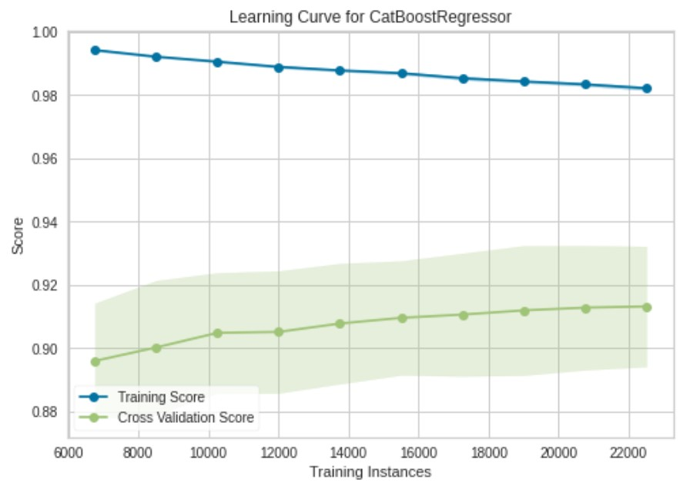
Learning Curve

Slide 40
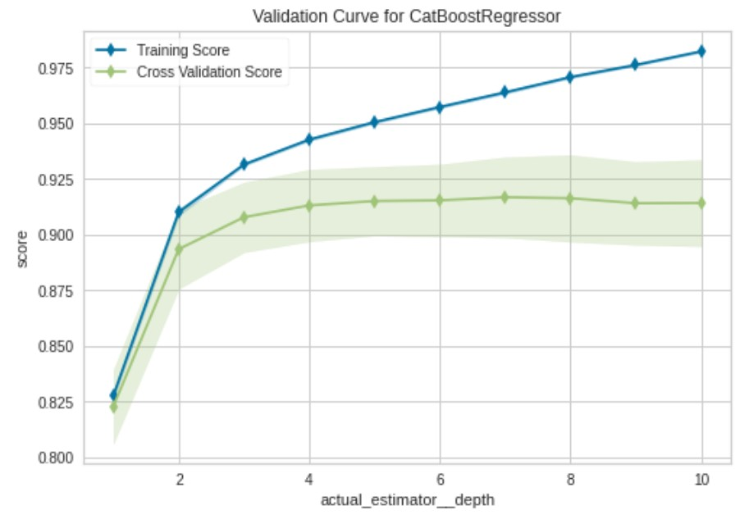
Validation Curve

Slide 41
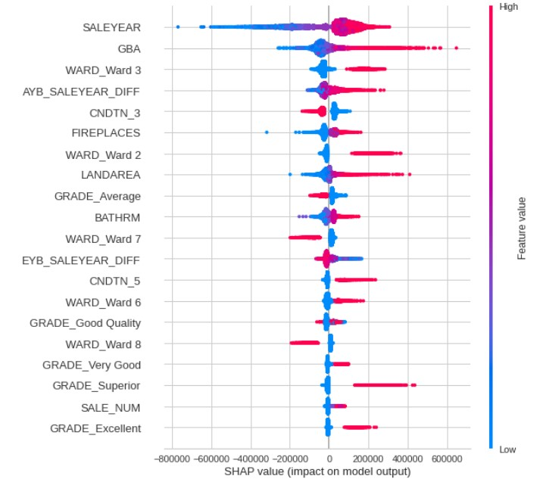
Feature
Importance

Slide 42
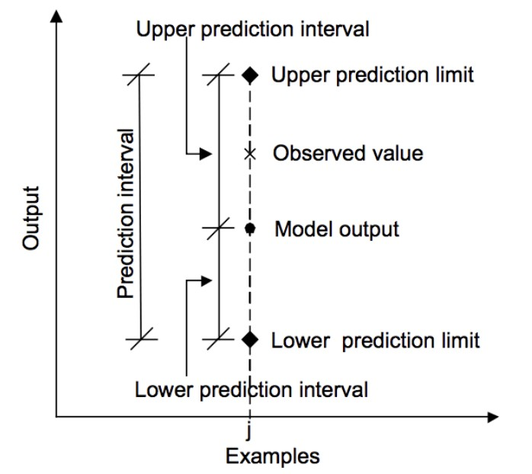
Predictions on Unseen Data (Test Set)
During prediction, we will use prediction interval. Prediction interval is a quantification of the uncertainty on a prediction which provides a probabilistic upper and lower bounds on the estimate of an outcome variable.

Slide 43
Model Result on Unseen Data
Model Improvement
Mean Absolute Error
Baseline Model Result
291,496 (Dummy regressor constant)
64%
106,349

Slide 44
4
Deployment

Slide 45
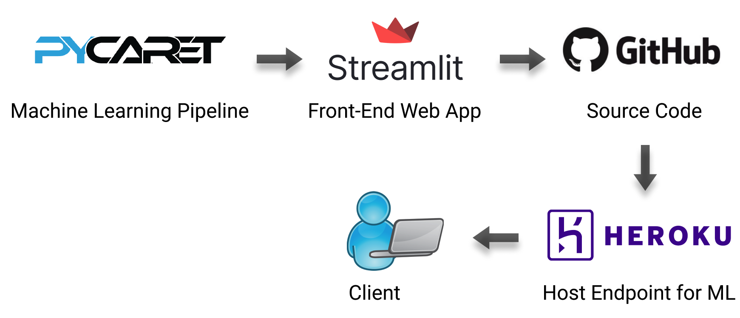
Deployment Workflow

Slide 46
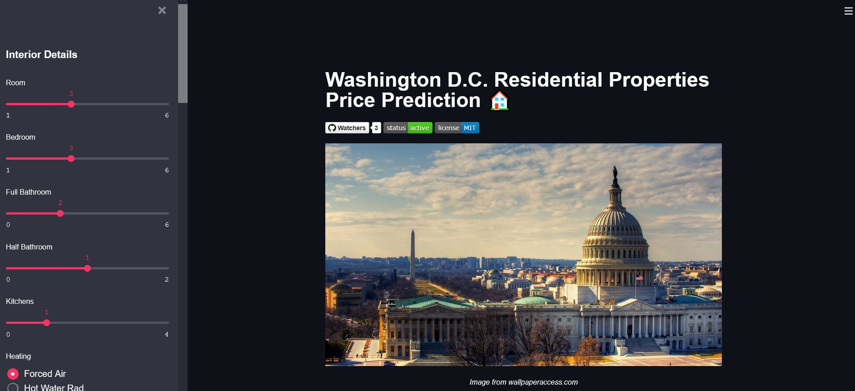
Deployment Page
We deployed the model to a webpage
Visit us: https://dc-residential-properties.herokuapp.com/

Slide 47
5
Business Case Study

Slide 48
Business Case Study Improvement Results
Seller
Buyer
526,131
540,000
⇧14%
⇩38%
460,000
Price (USD)
Price (USD)
335,579
Before
After
Before
After
Unqualified
Record
(ind. 12589)
Model
Result
Unqualified
Record
(ind. 4676)
Model
Result
Avoid underpricing and increase 14% of potential profit
Avoid overpricing and reduce 38% of potential loss

Slide 49
Business Case Study Prescriptive Analysis
A seller want to sell his property with specification :
LANDAREA : 2000
GBA : 1500
AYB : 2015
STYLE : 2.5 STORY
BATHRM : 2
HF_BATHRM : 0
BEDRM : 5
GRADE : Very Good
CNDTN : Very Good
KITCHENS : 1
FIREPLACES : 1
AC : N
WARD : 3
Result & Suggestion
1,015,906
1,002,665
991,965
979,144
Price (USD)
Alt. 1
Add Toilet
Alt. 2
Install AC
Model
Result
Alt. 3
Add Toilet &
Install AC
Cost : ±5,000
Cost : ±2,900
Cost : ±7,900
Suggesting customer to add more features in order to increase their property value

Slide 50
6
Conclusion and Recommendation

Slide 51
Conclusion
After testing several models, we conclude that CatBoost performed the best with MAE 106,349 on unseen data, which has been improved by 64% from baseline model.
The price predictor is available in deployed page, where our customer can access and predict property price in less than 2 seconds.
Based on the case study, the model can actually help customer to avoid overpricing and underpricing. We can also suggest several improvement to maximize their property value.

Slide 52
Recommendation
Despite having produced a working application that meet our initial requirements. There are various improvements that can be made in the future. Such as:
Consider more factors affecting housing prices (e.g distance to public transportation, public facilities, etc.) by analyzing more than one dataset.
Property price is increasing yearly. Consider to also include feature that can accommodate this, such as inflation, interest rate.
Add more functionalities into the application to increase user experience.

Slide 53
Recommendation (continued)
Likewise, there are several possibilities to expand the business :
Utilizing the price predictor to be a developer. Buy property at low price, improve its features to increase the price, and sell.
Build a property e-commerce app and integrate with this price predictor

Slide 54

THANKS!
Purwadhika JCDSAH 0402-4
Matplotlib Team
Elvan Selvano
Gusti NA Kresna
Rafif Hendrawan
Github Repository

